Slide 1





Customer Purchase Behavior Analysis in Retail
To turn raw retail data into actionable customer insights and business strategies using Data Science and Power BI.”
Presented by: AYESHA BANU
linkedin.com/in/ayeshabanu
ayesha24banu@gmail.com
github.com/ayeshabanu
July 2025

Slide 2

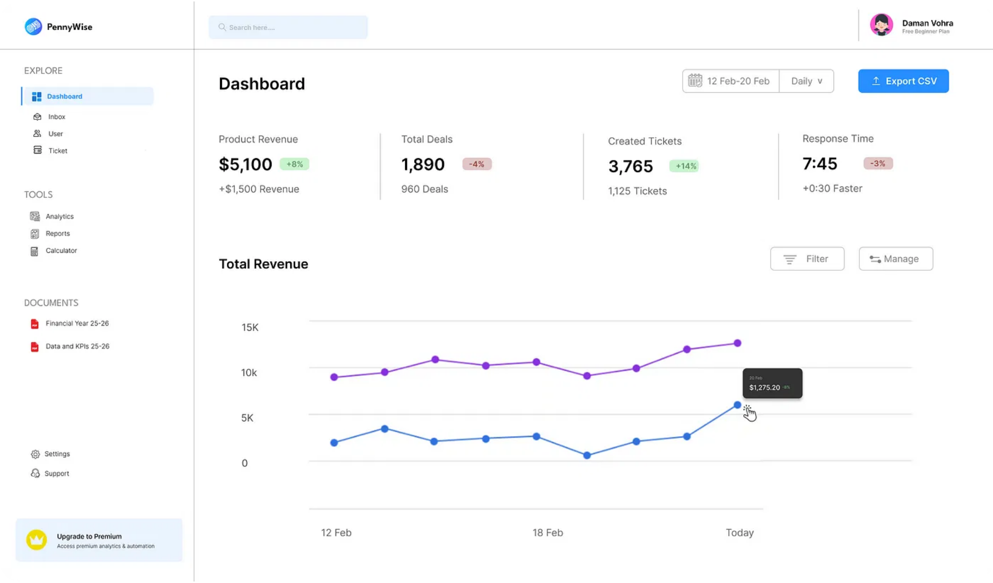



Business Challenge
The retail business lacked visibility into customer behavior.
Marketing was not personalized — all customers treated the same.
No data-backed bundling or upselling strategies.
Performance reports were manual, static, and time-consuming.
"Before our solution, the client was sitting on a goldmine of customer data but wasn't extracting insights."

Slide 3








What We Aimed to Achieve
Understand and segment customers based on their behavior.
Discover meaningful product pairings using Market Basket Analysis.
Customer Insights
Data Visualization
Visualize business KPIs in a single, interactive dashboard.
Empower marketing and leadership with data they can act on.
Interactive Dashboard
"Our aim was to bridge the gap between data and decision-making."
Product Bundling

Slide 4



Project Objectives
Identify purchasing patterns and trends across customer segments
Segment customers based on recency, frequency, and monetary value
Discover product associations for cross-selling opportunities
Develop targeted marketing strategies for each customer segment
Create interactive dashboards for real-time business insights
"Our goal was to transform raw retail data into actionable business strategies."

Slide 5

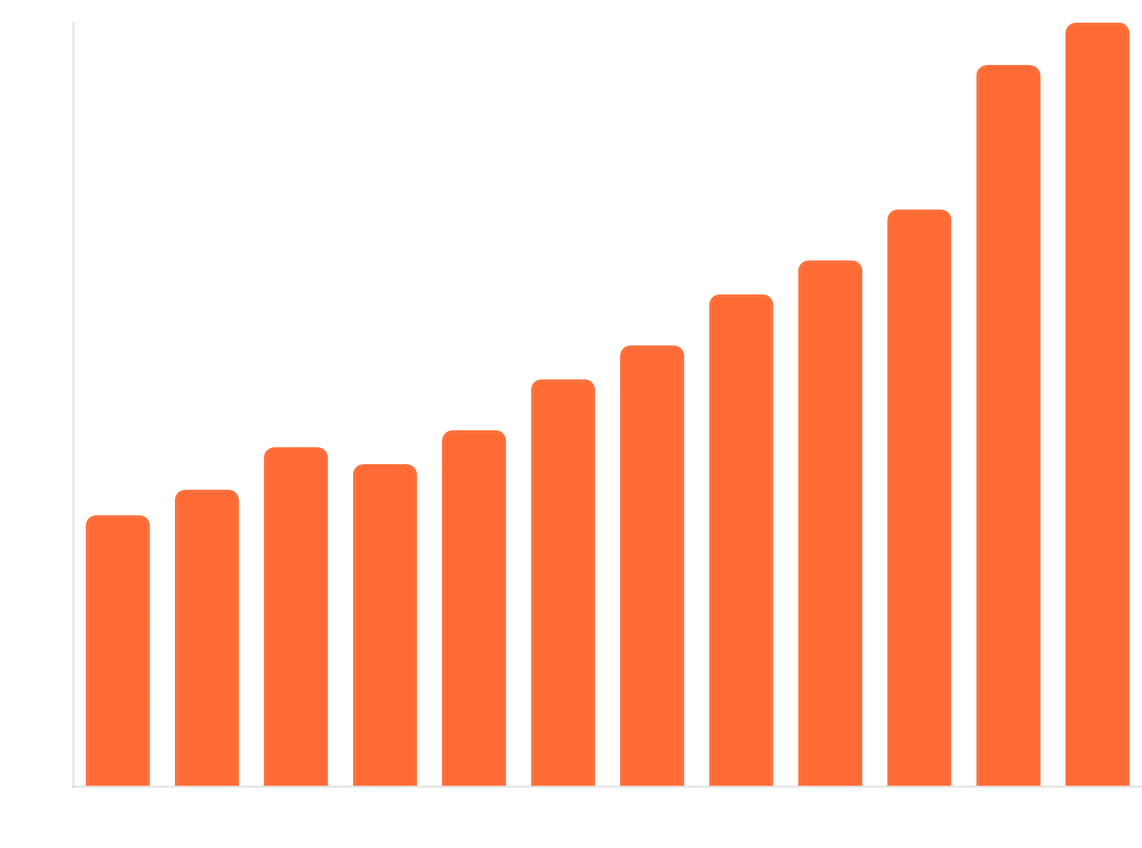



Dataset Overview
Transaction Distribution by Month
Source: Online Retail II UCI Dataset
A transnational data set containing all transactions occurring for a UK-based online retail between 01/12/2009 and 09/12/2011.
Key Features:
InvoiceNo, StockCode, Description
Quantity, InvoiceDate, UnitPrice
CustomerID, Country
779K+
4,000+
38
Transactions
Products
Countries

Slide 6
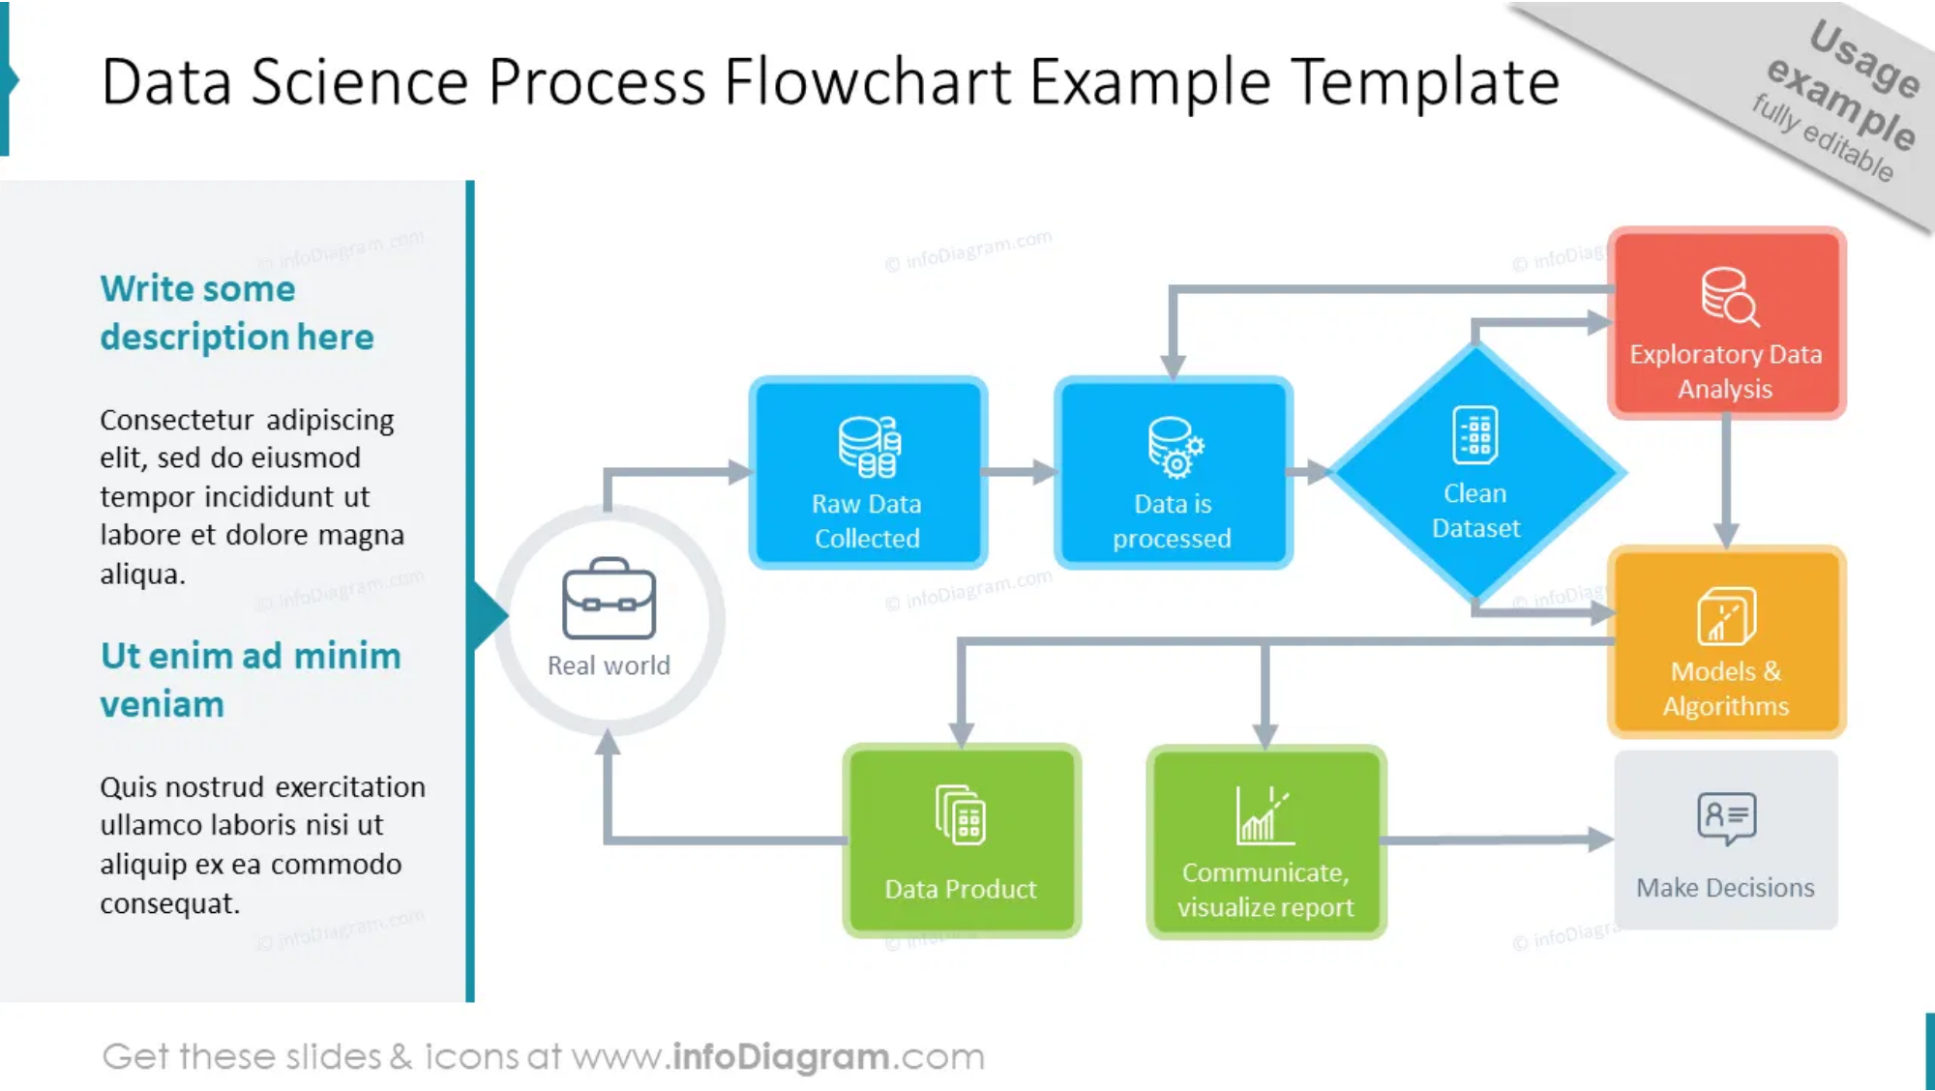
End-to-End Analytical Workflow
1
Cleaned and transformed
779,000+
transactions.
2
Performed
RFM scoring
(Recency, Frequency, Monetary
value).
3
Clustered customers using
KMeans
to form actionable
segments.
4
Applied
Apriori algorithm
for discovering product
bundles.
5
Designed a
4-page interactive Power BI
dashboard.
"This solution was not just analytical—it was business-first, focusing on marketing, customer insights, and product bundling."

Slide 7


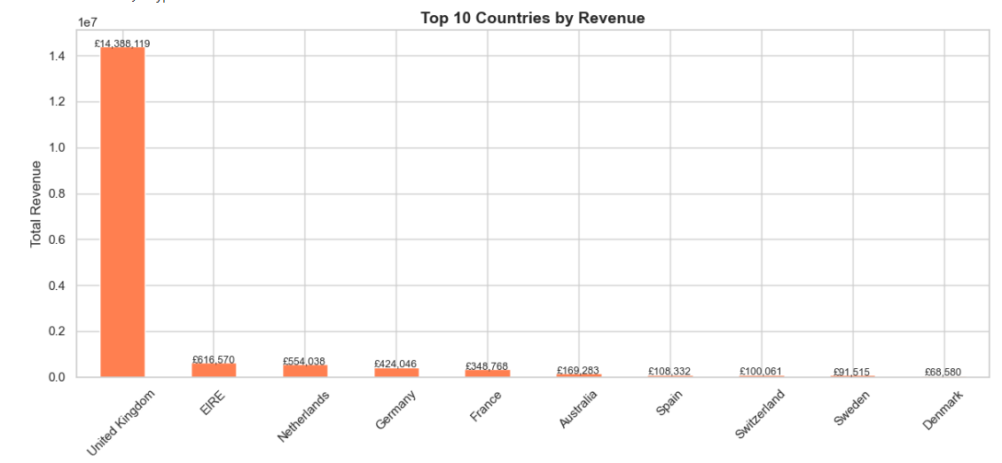



Exploratory Data Analysis Insights
Revenue by Country
United Kingdom
drives
85%
of total sales, with Germany
and France as distant followers.
November-December
shows peak revenue, indicating
strong seasonal purchasing patterns.
Weekdays between
10 AM – 2 PM
are peak buying hours,
crucial for inventory and staffing.
Top-selling products include
gift items
and
home
decorations
, with seasonal variations.

Slide 8
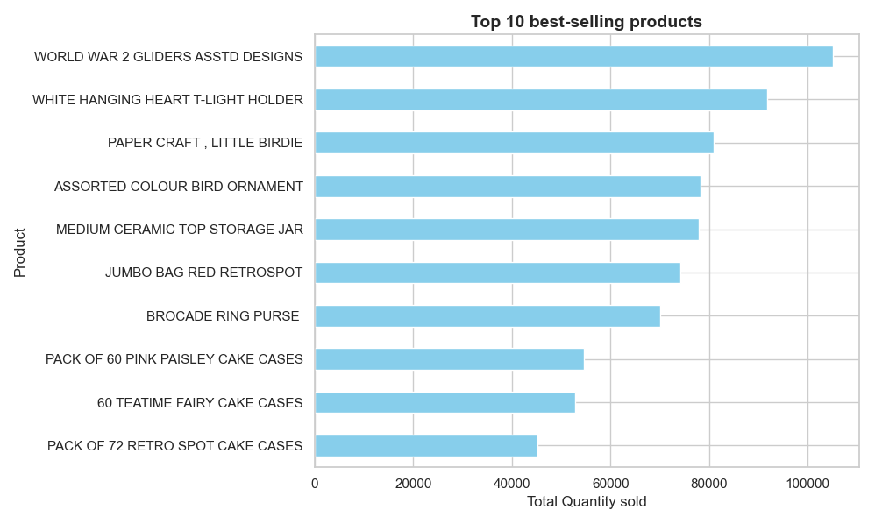
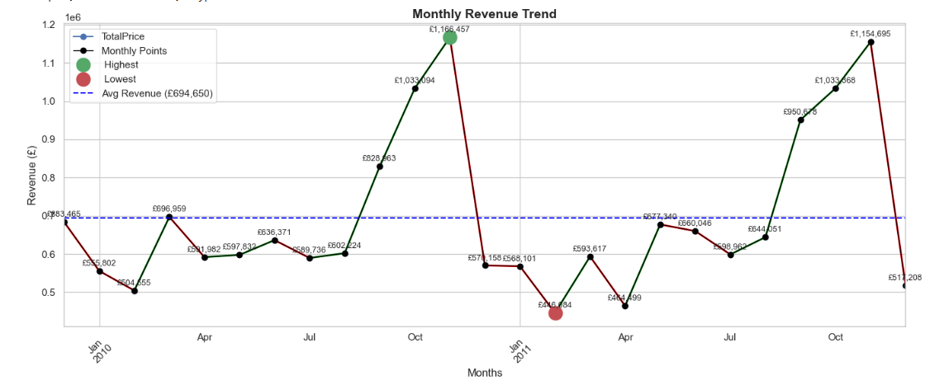
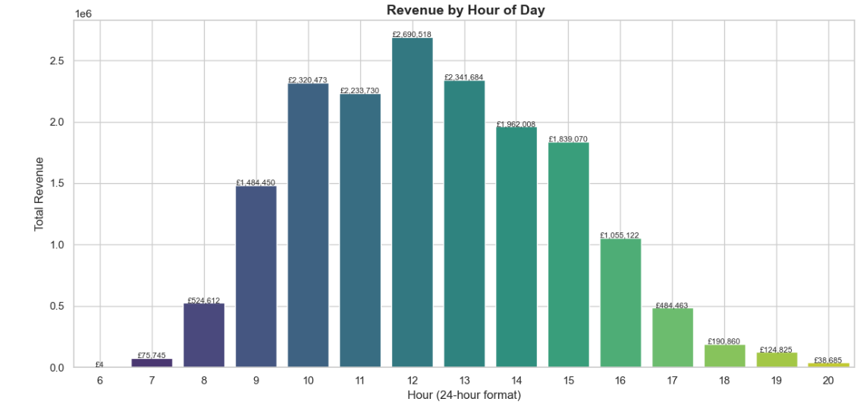
Top-selling products
Monthly Revenue Trend
Hourly Revenue Trend

Slide 9
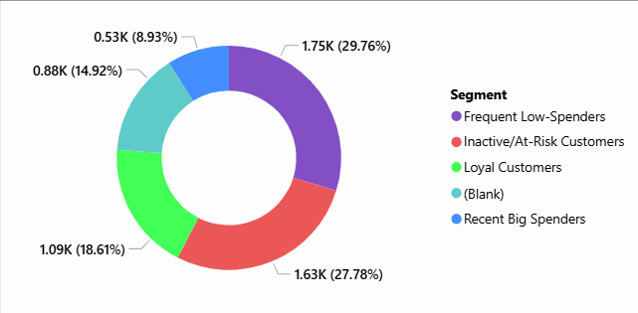
RFM Analysis: Understanding Customer Value
What is RFM Analysis?
Customer Segments by RFM Score
A customer segmentation technique that uses purchase behavior to identify your most valuable customers.
R
Recency
- How recently did the customer purchase?
Recent buyers are more likely to buy again.
F
Frequency
- How often do they purchase?
Frequent buyers are more engaged and loyal.
M
Monetary
- How much do they spend?
Big spenders generate more revenue.
"RFM analysis helped us identify which customers to prioritize for different marketing campaigns."

Slide 10
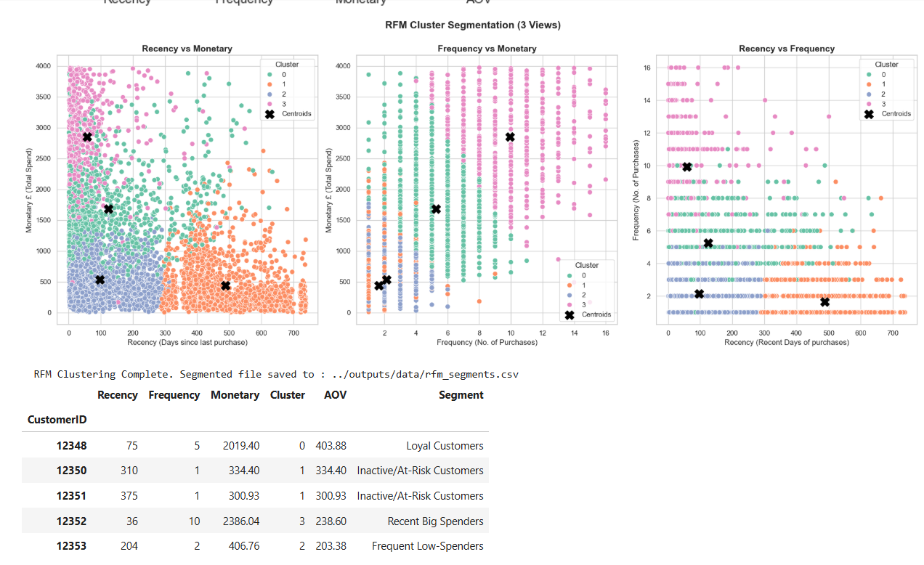
Customer Segments by RFM Clusters

Slide 11

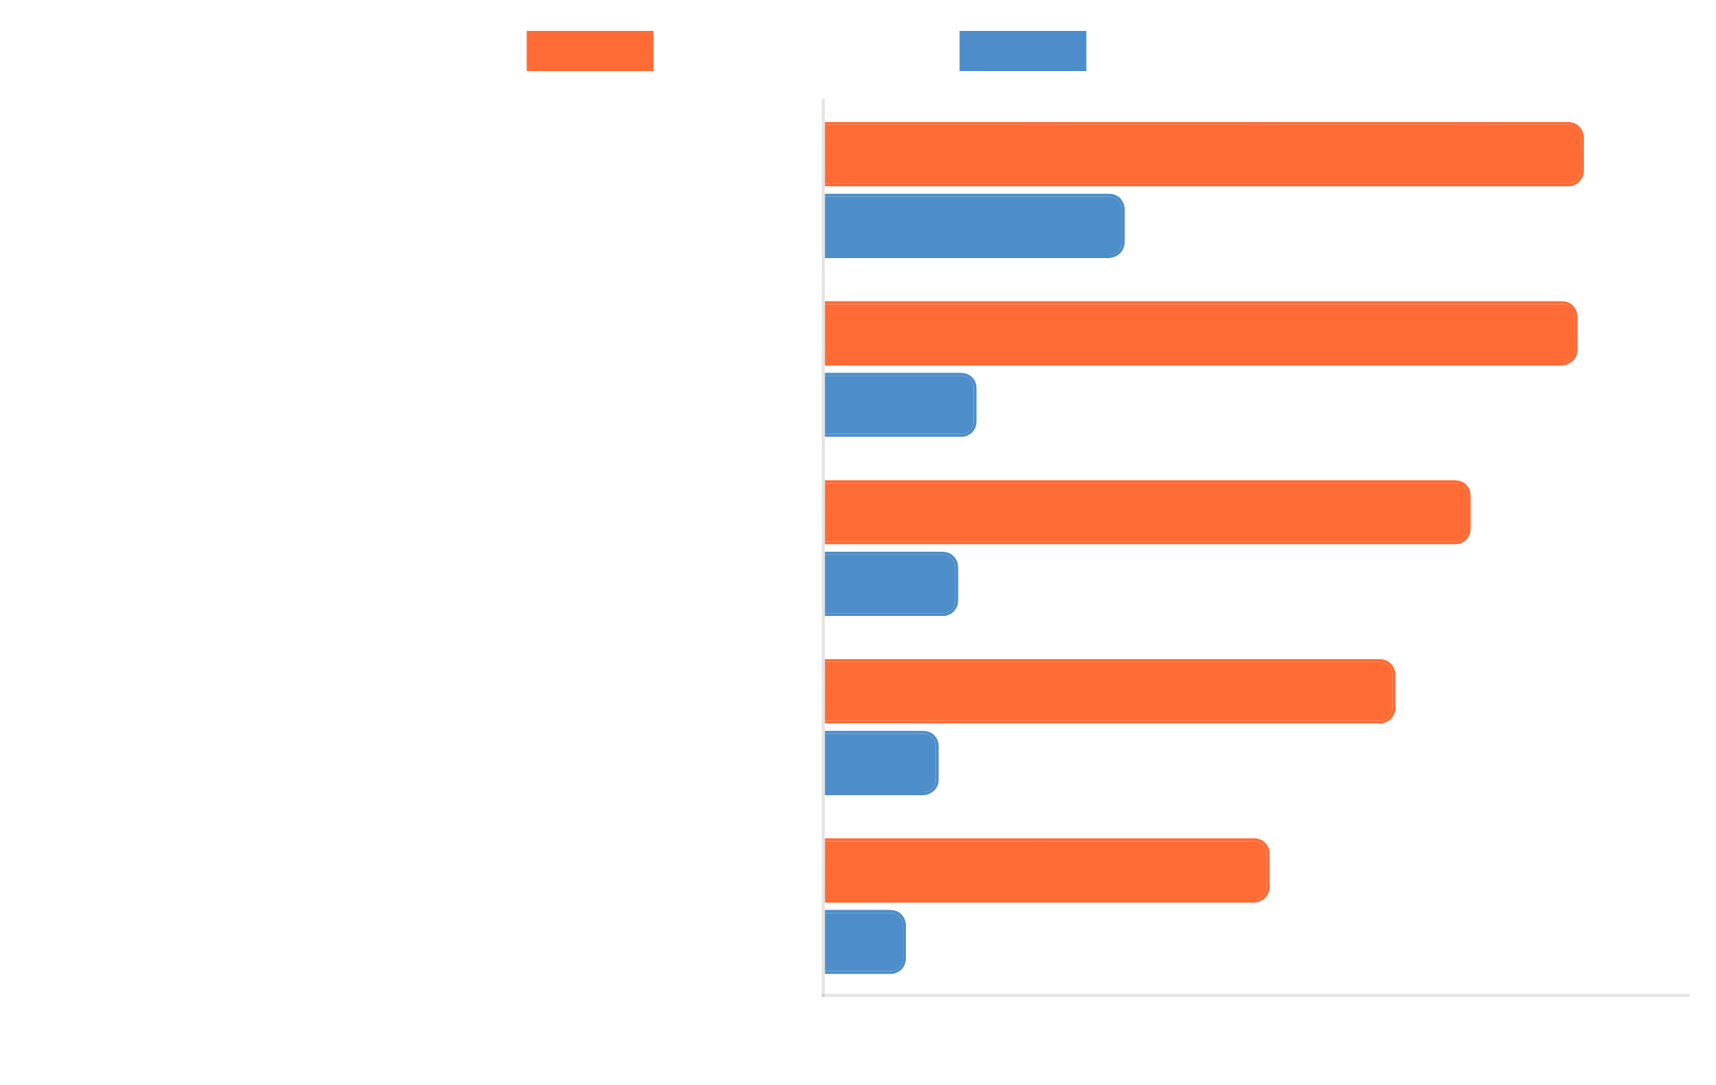
Market Basket Analysis: Product Associations
What is Market Basket Analysis?
Association Strength by Product Pair
A data mining technique that discovers relationships between products that are frequently purchased together, enabling strategic product bundling and cross-selling.
Top Association Rules Discovered:
ROSES REGENCY TEACUP AND SAUCER → GREEN REGENCY TEACUP AND SAUCER
Confidence:
70.36%
27.88
Confidence:
Lift:
SWEETHEART CERAMIC TRINKET BOX → STRAWBERRY CERAMIC TRINKET BOX
Confidence:
69.77%
Lift:
14.19
WOODEN PICTURE FRAME WHITE FINISH → WOODEN FRAME ANTIQUE WHITE
Confidence:
59.89%
Lift:
12.49
"These association rules provide clear opportunities for product bundling and strategic store placement."

Slide 12

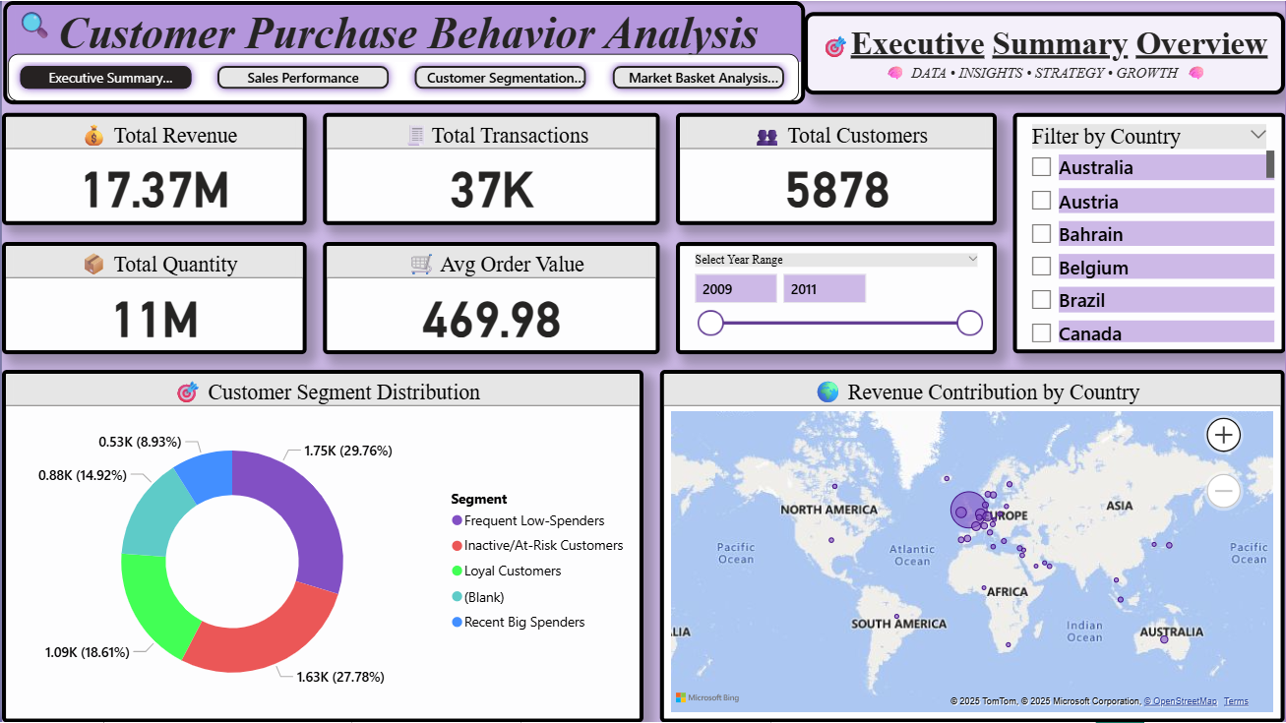

What Our Dashboard Helps You Answer
Executive Summary Overview
How's the overall performance?
View Revenue, Orders, Average Order Value at a glance
When do we sell more?
Monthly sales trends and peak purchasing hours
Who are our customers?
RFM segments: Loyal, At-Risk, Hibernating with detailed metrics
What do they buy together?
MBA rules with Lift & Confidence metrics for product bundling
How can I slice this data?
By Country, Date, Product, Customer Segment for targeted analysis
"It's not just visuals—it's an exploration tool for decision-makers."
Interactive 4-page Power BI dashboard with Executive Summary, sales Trends Customer Segments, and Market Basket Analysis

Slide 13
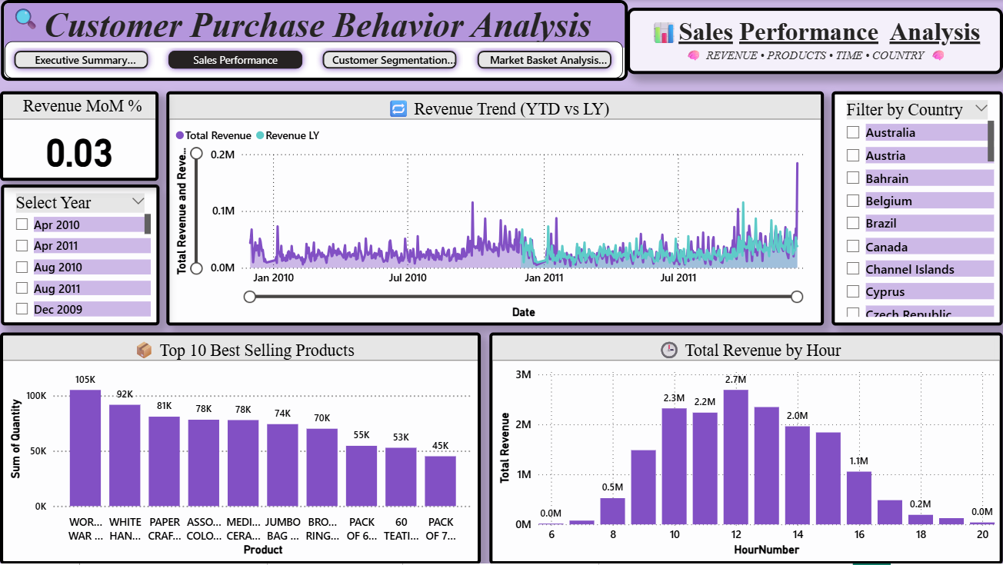
Sales Performance Analysis

Slide 14
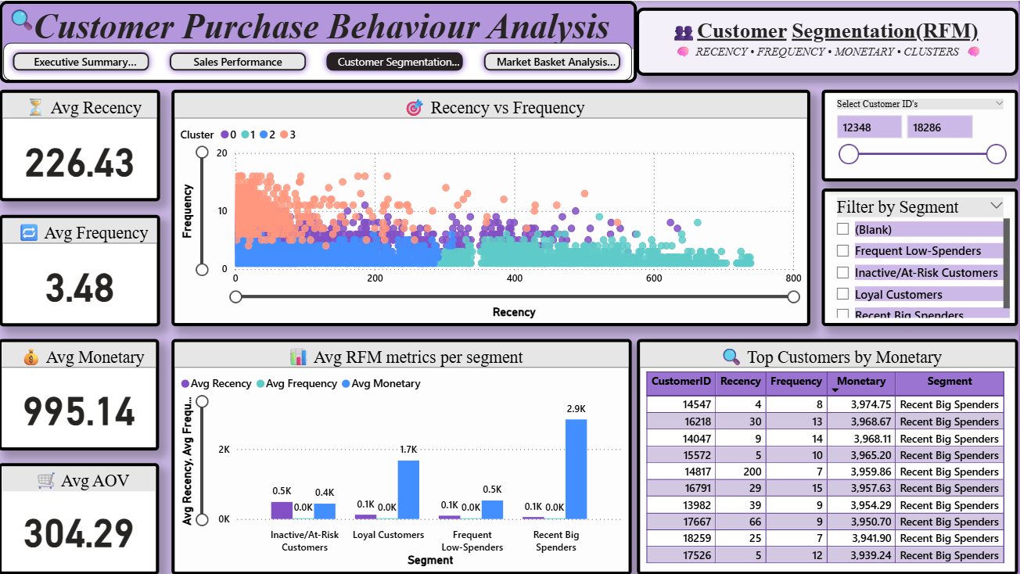
RFM Customer Segmentation Analysis

Slide 15
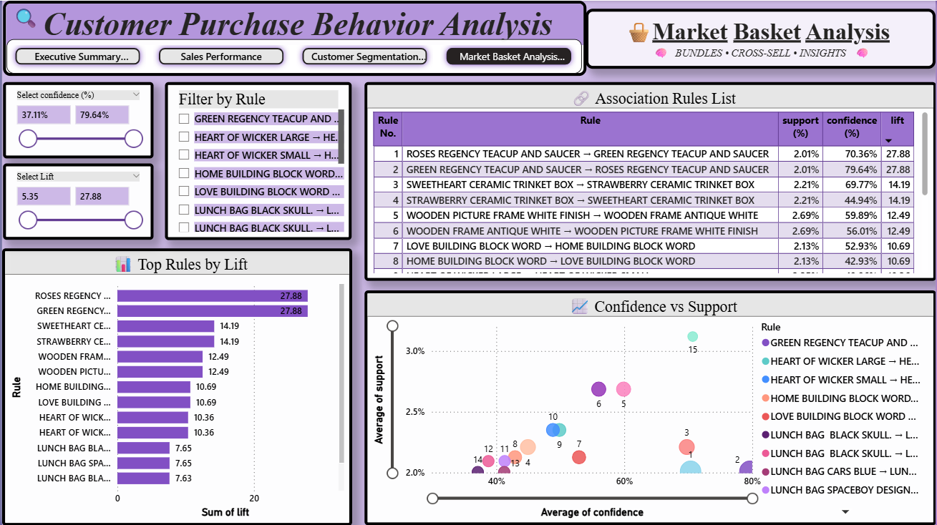
Market Basket Analysis

Slide 16

Insights That Matter
UK drives 85%
of total sales, with Germany and France as
distant followers.
Peak revenue
observed during November–December,
MBA Rule Example:
indicating strong seasonal patterns.
"Buyers of
Tea Light Holders
also purchase
Wicker
"
Hearts
Loyal customers (~32%)
contribute over
60% of sales
,
Confidence:
71%
Lift:
2.3
highlighting the importance of retention.
Market Basket Analysis
revealed strong product
associations for bundling opportunities.

Slide 17






What the Client Should Do Next
Launch
re-engagement campaigns
for At-Risk
customers before they become inactive.
Bundle frequently co-purchased items
and promote
them during peak seasons (Nov-Dec).
Re-engagement Campaign
Product Bundling
Personalize offers
using segment behavior and past
purchases to increase conversion rates.
Monitor KPIs and campaign effectiveness
monthly via
the dashboard to optimize strategies.
Personalized Offers
KPI Monitoring
"These are not just analytics—they're business levers that can directly impact revenue and customer retention."

Slide 18



Business Impact of This Solution
Actionable Intelligence
- Transformed raw data into clear
Projected Business Impact by Category
business strategies.
Revenue Growth
- Identified opportunities for 15-20%
increase through targeted marketing.
Better Targeting
- Reduced marketing waste by focusing
on high-value segments.
Time Efficiency
- Automated reporting reduced analysis
time by 75%.
Reduced IT Dependency
- Self-service dashboard
empowers business users.
"This solution delivers both immediate tactical wins and long-term strategic advantages."

Slide 19

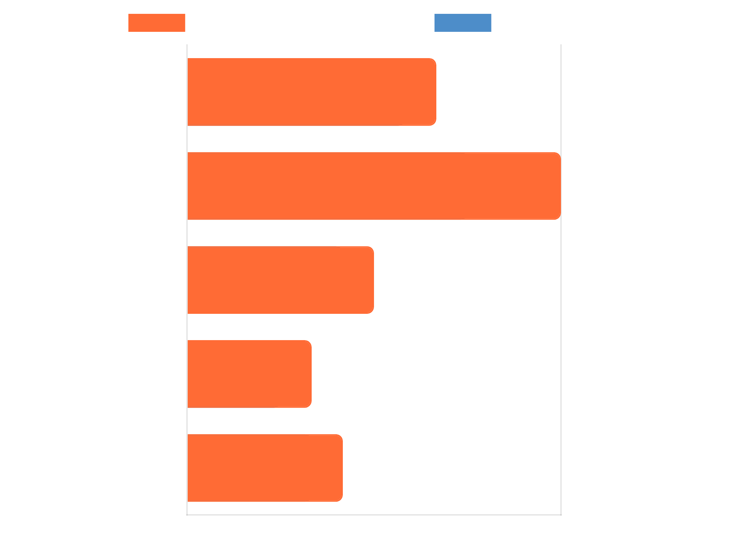




Opportunities for Expansion
Real-time Analytics
- Implement streaming data
Implementation Timeline & Complexity
processing for instant insights.
Predictive Models
- Forecast customer behavior and
product demand.
Web App Deployment
- Create mobile-friendly dashboard
for on-the-go access.
Automated Reporting
- Schedule regular insights
delivery to stakeholders.
Cloud Integration
- Enable secure sharing and
collaboration across teams.
"This solution provides a foundation that can be expanded to meet evolving business needs."

Slide 20



Thank You
This project transformed raw retail transaction data into actionable business insights, enabling data-driven decision making for targeted marketing and inventory optimization.
Project Impact Assessment
Key Takeaways
Customer segmentation reveals high-value targets for personalized marketing
Product bundling opportunities identified through market basket analysis
Seasonal trends guide inventory planning and promotional timing
Interactive dashboard enables ongoing monitoring and decision support
Questions?

